Slide 1
Analysis of cosmic rays using drift tubes detectors
The code that we are presenting is a possible distributed way to obtain trajectories of muons drifting inside tube detectors.
Luca Castelli
Alessandro Marcomini
Pietro Miglioranza
Andrea Scanu
Management And Analysis of Physics Datasets – Part B
Padova, 7th September 2021

Slide 2


Distributed calculus
This kind of analysis are highly parallelizable, so we have chosen to use a distributed framework.
We have made the choice of framework due to the high compatibility with Python and Pandas.

Slide 3
Cluster settings
We opted for a cluster made using 4 VMs with the same chacteristics provided by CloudVeneto:
CPU 4 cores
1 thread per core
RAM 8 GB
We disposed with the following configuration:
1 scheduler
16 workers
1 core and 1 thread per worker
RAM 32 GB
 | Workers | Threads per worker | Processing time (s)
Configuration 1 | 4 | 4 | 2090
Configuration 2 | 8 | 2 | 830
Configuration 3 | 16 | 1 | 430
*Processing time is an order of magnitude because it depends also on factors unrelated to cluster configuration

Slide 4
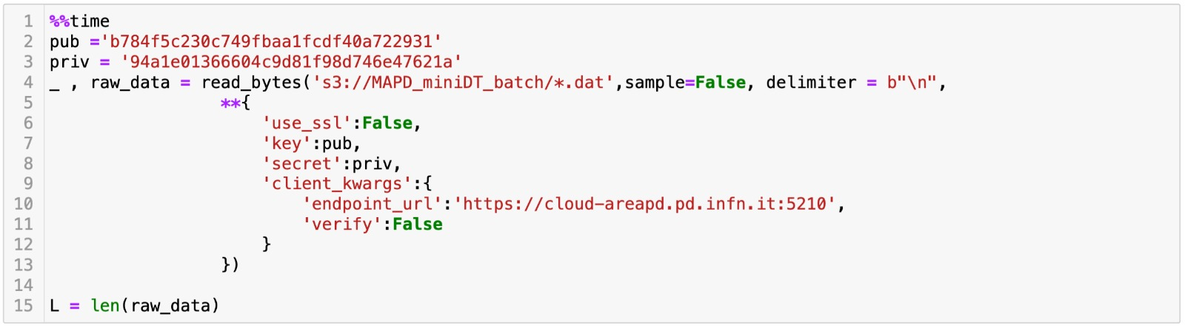
Retrive the dataset
The dataset is composed of 81 files located inside a S3 bucket in a CloudVeneto repository. To retrieve the files we used the following code:

Slide 5

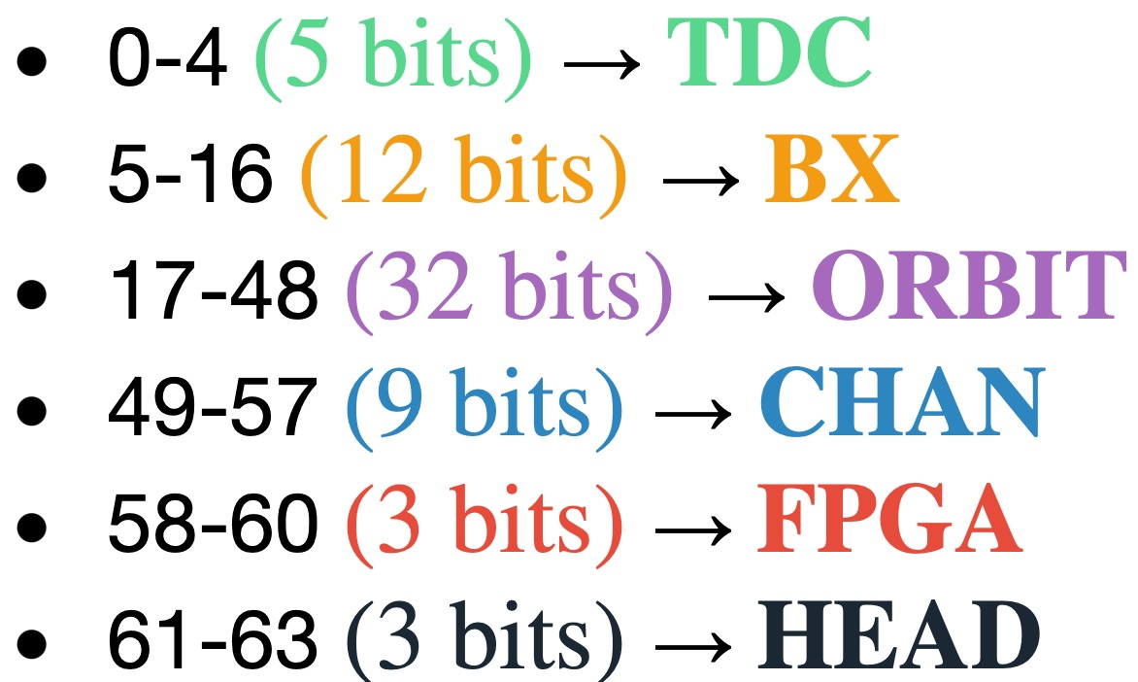
Decoding data
The dataset is structured in strings of 64 bit encoded as in the image

Slide 6

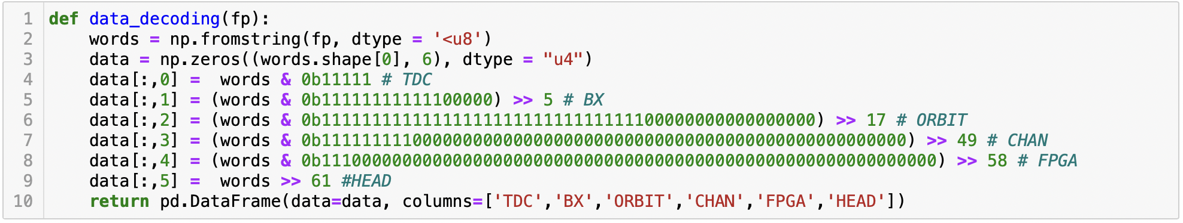

Decoding data
We have used the code below solution to translate the dataset into a dataframe

Slide 7
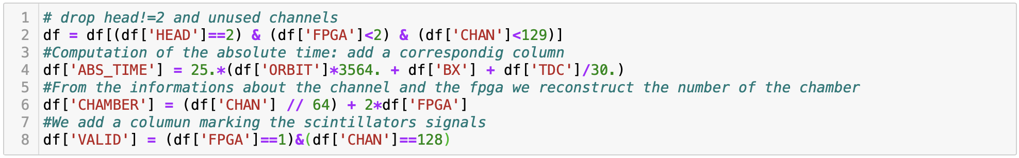
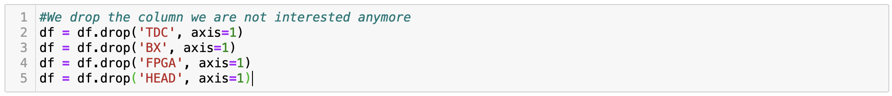
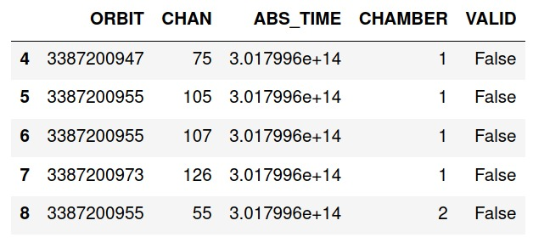
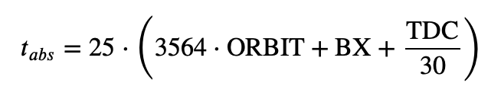
Preliminary Operations
Removal of ancillary data
Removal of unused data:
Signals with FPGA>1
Signals with CHAN>128
Absolute time computation
Add new columns:
VALUE
CHAMBER
Drop the columns we are not interested in

Slide 8
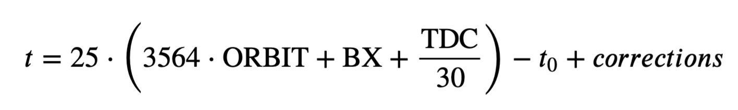
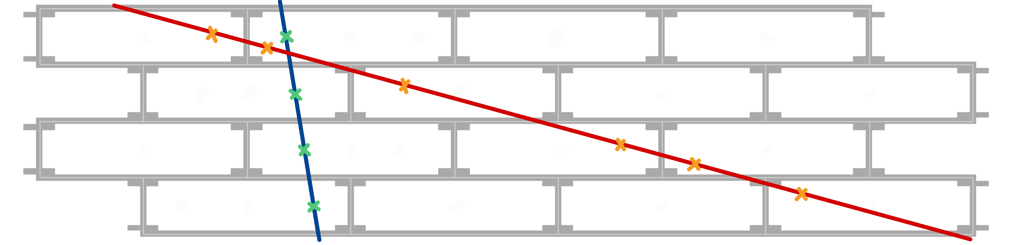
First stage filtering: group by ORBIT
Drop the orbits with more than 1 scintillator signal:
Filter with respect to the number of hits whitin an orbit:
n_hits > 2 and n_hits < 18
to avoid multiple muons events.
In order to univocally determine the drift time a univocally determined t0 is needed
Accepted muon event
Too much sloping: discarded

Slide 9
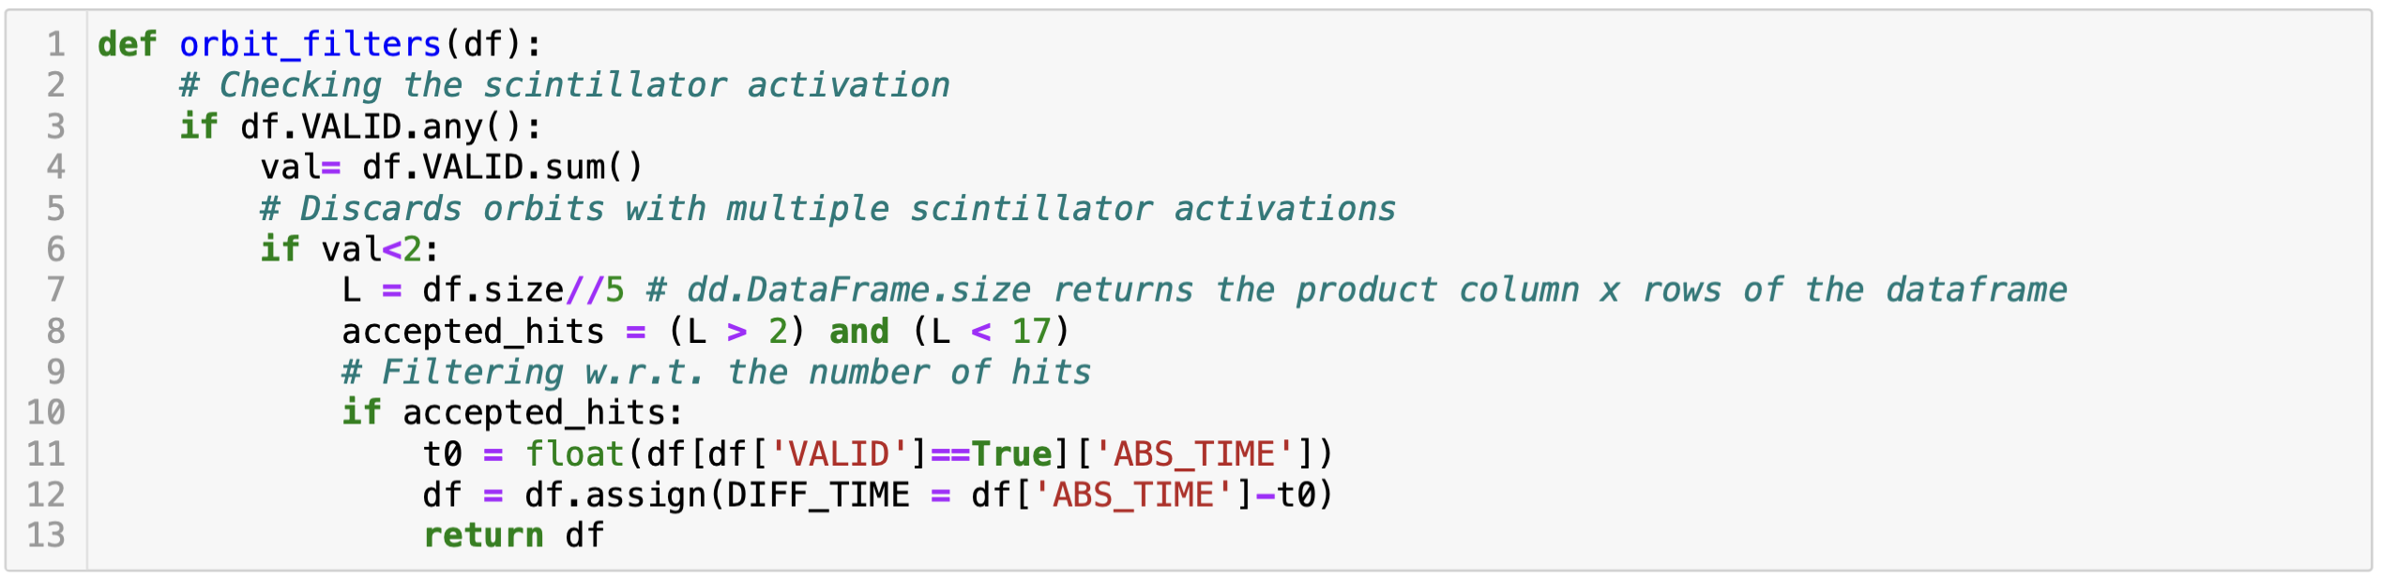


First stage filtering: group by ORBIT
Filters
Drift time computation without corrections

Slide 10



Drift times correction
t0 needs 2 types of corrections:
Signal trasmission delay: t0 is delayed of 95 ns with respect to the collected signal
Fine corrections to account chamber by chamber differences

Slide 11
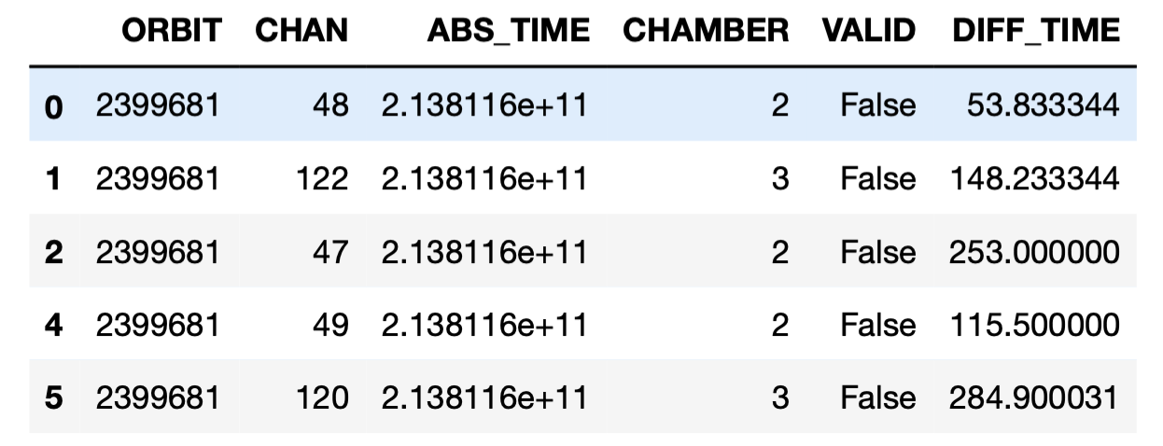
Drift times correction
t0 needs 2 types of corrections:
Signal trasmission delay: t0 is delayed of 95 ns with respect to the collected signal
Fine corrections to account chamber by chamber differences

Slide 12


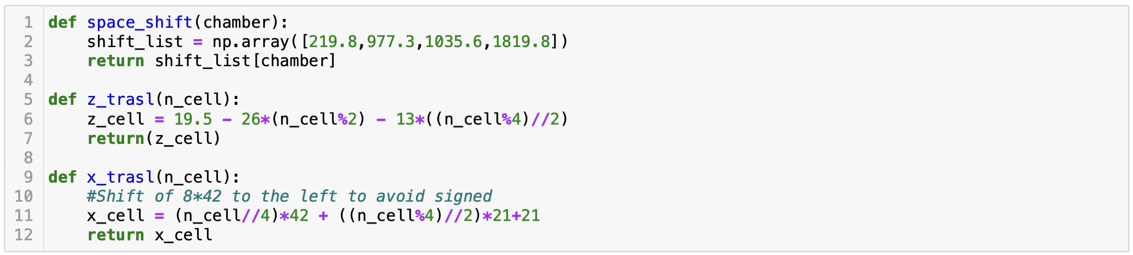
Spatial coordinate estimation
X coordinates can be reconstructed by means of the drift time of the electron cloud and the correspondig cell:
Drift time
Z coordinate can be reconstructed starting from the information about the correspondig chamber and the cell:
z coordinate estimation
x coordinate estimation

Slide 13

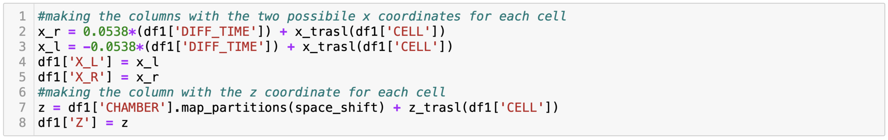
Spatial coordinate estimation
X coordinates can be reconstructed by means of the drift time of the electron cloud and the correspondig cell:
Drift time
Z coordinate can be reconstructed starting from the information about the correspondig chamber and the cell:

Slide 14
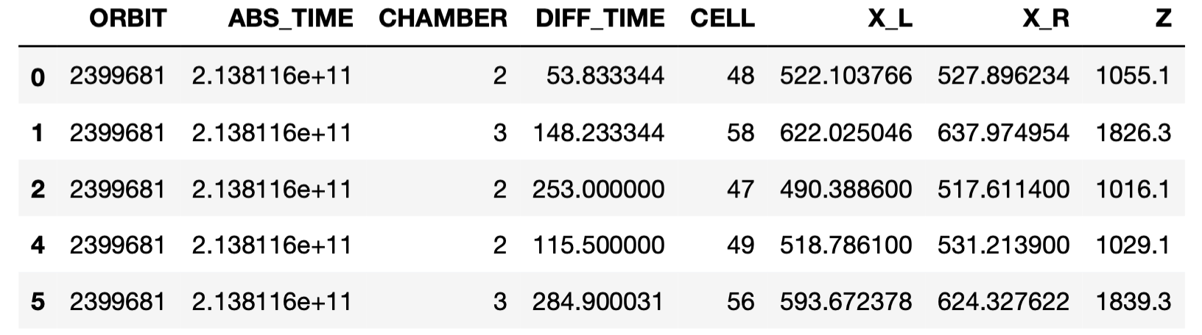
Spatial coordinate estimation
X coordinates can be reconstructed by means of the drift time of the electron cloud and the correspondig cell:
Drift time
Z coordinate can be reconstructed starting from the information about the correspondig chamber and the cell:

Slide 15
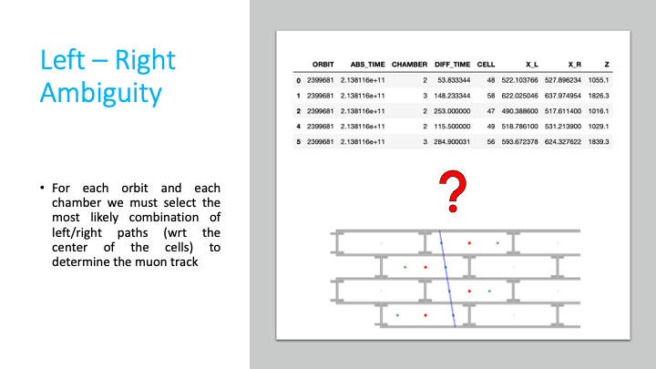

Slide 16
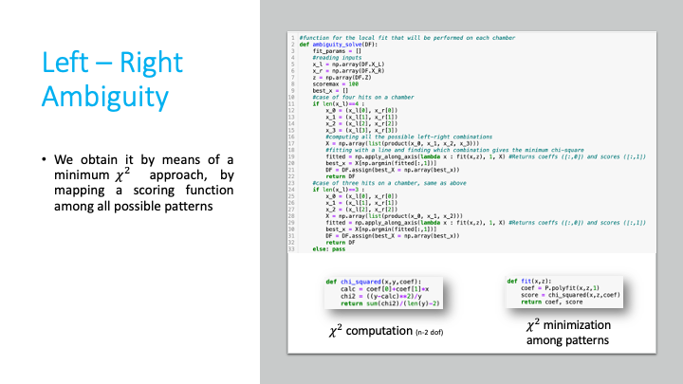

Slide 17
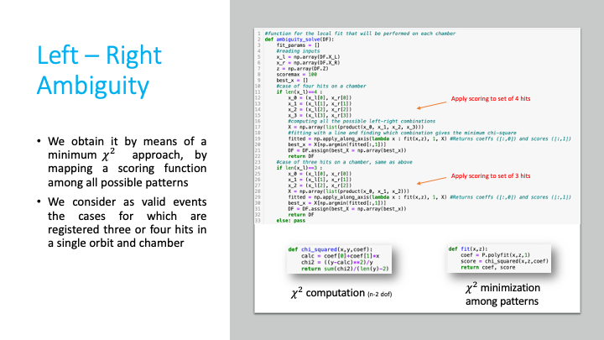

Slide 18
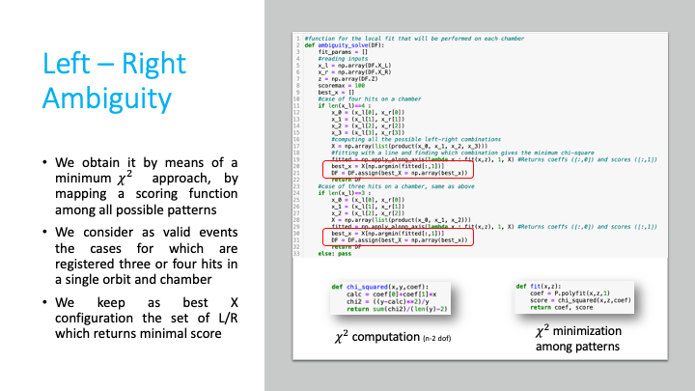

Slide 19
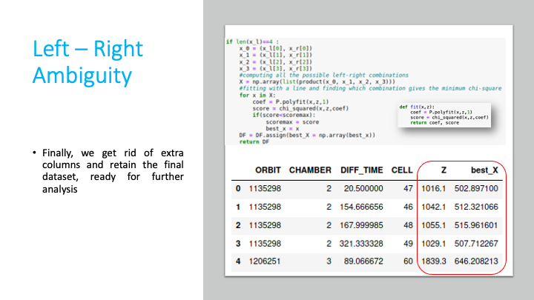

Slide 20
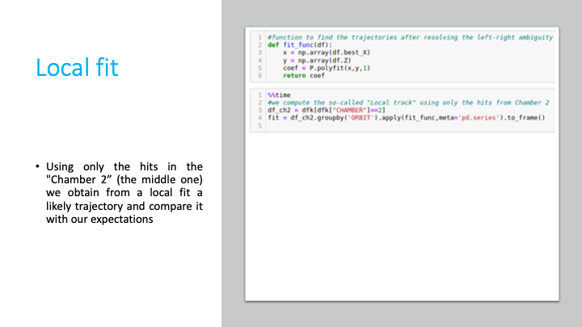

Slide 21
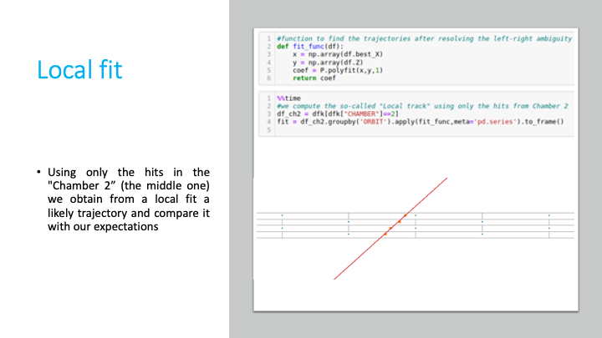

Slide 22
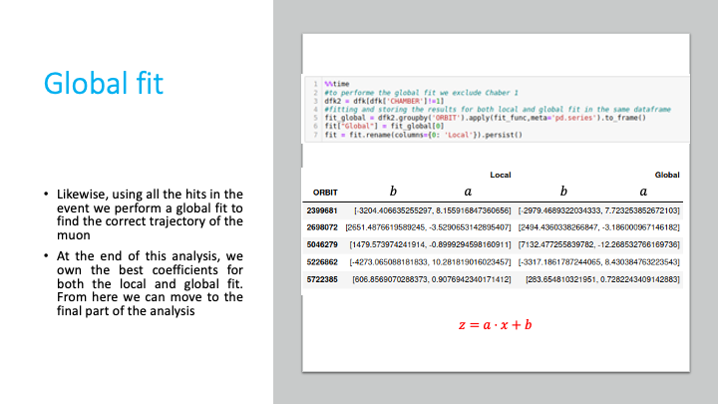

Slide 23
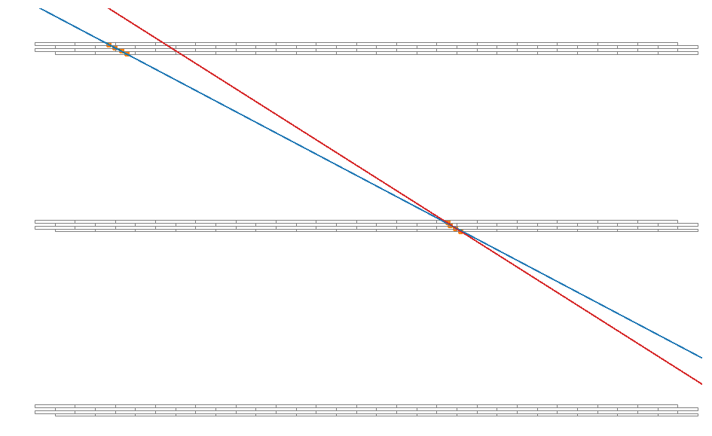
Angular resolution
We confronted the angular coefficient obtained by the local fit and the global fit to have an estimation of the angular resolution of the chambers.

Slide 24
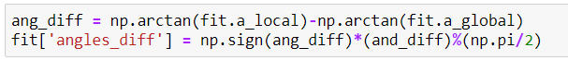
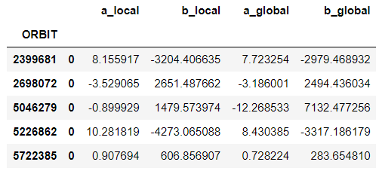
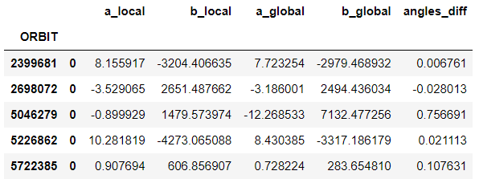
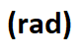
Angular resolution
We added a column with the difference in radiant between the two trajectories.

Slide 25
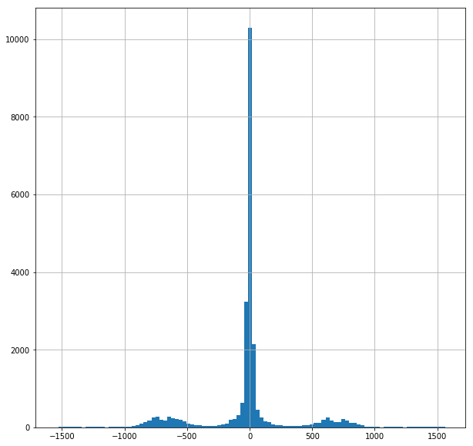
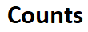
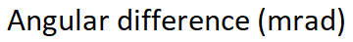
Angular resolution
The total amount of angles, one for each orbit is distributed as in this histogram:

Slide 26
Angular resolution
The total amount of angles, one for each orbit is distributed as in this histogram:

Slide 27
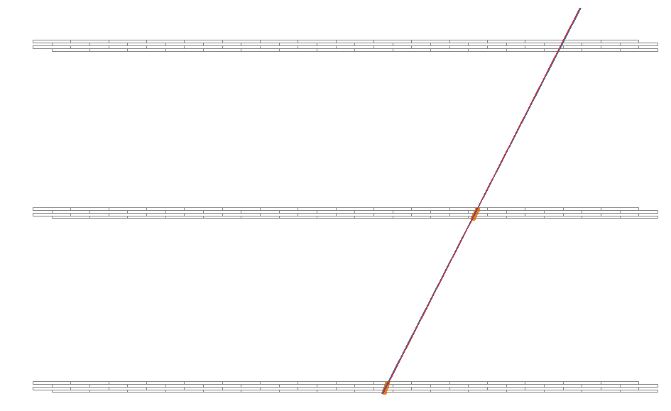
Some visual results:
A perfect reconstruction

Slide 28
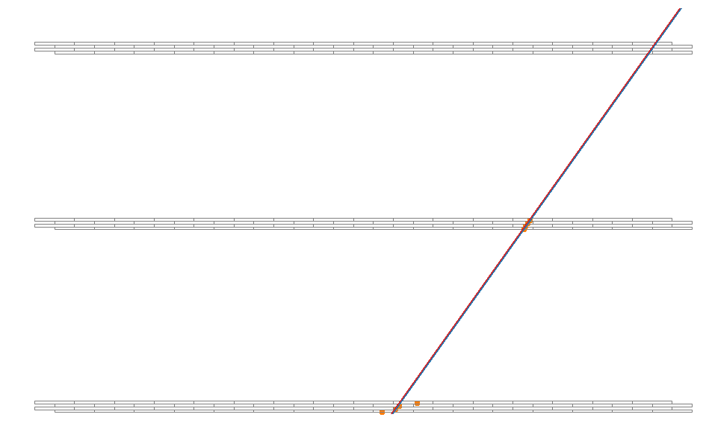
Some visual results:
A good reconstructed trajectory

Slide 29
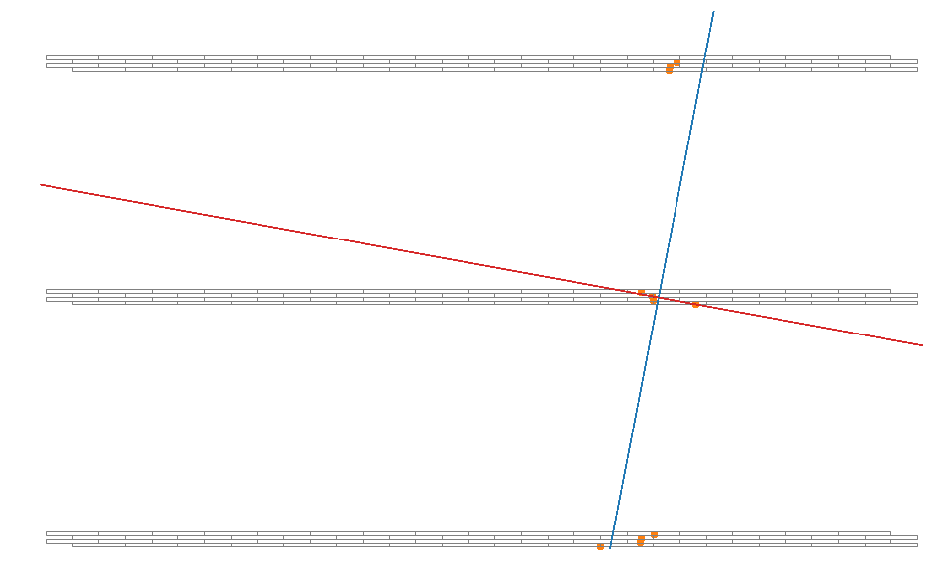
Some visual results:
A bad reconstructed trajectory

Slide 30
Angular resolution
Looking at the histogram we can say that there is not a great difference between global and local data:
mean: -0.8 mrad, stdev: 60 mrad
The efficiency is over 95%

Slide 31
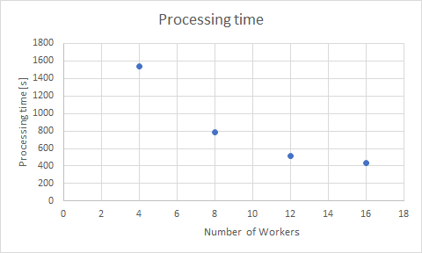
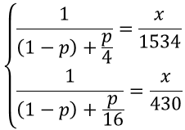
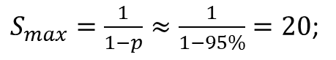
Processing time
Workers | Processing time [s]
4 | 1534
8 | 782
12 | 511
16 | 430
As expected, more workers we have, the faster the algorithm it is, even though we can see from the plot an asymptotic behaviour, as expected from Amdahl's law:
$S_{max}=\frac{1}{1−p}≈\frac{1}{1−95\%}=20$;
"p" is obtained by solving the system of equations:

Slide 32
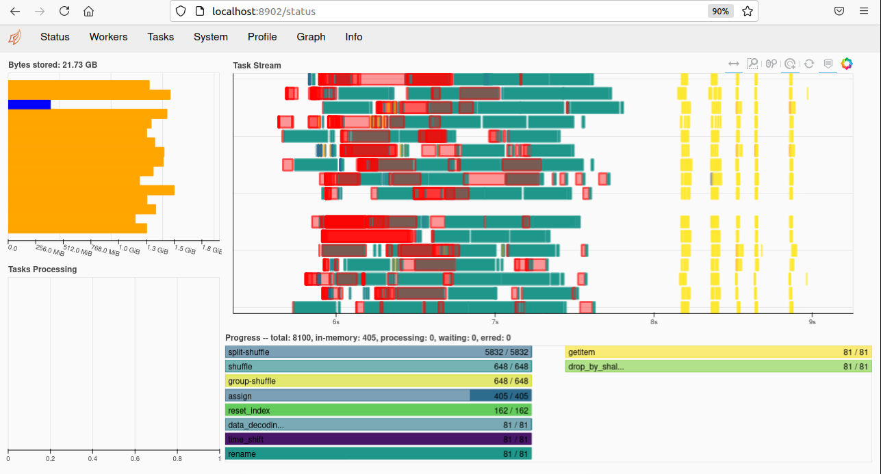
Processing time
The time the algorithm needs to run is about 7 minutes. This result has been achieved using properly the "persist" function of dask. Without it would take up to 20 minutes.
We think that this code is not optimized, because we can see that the various processes occupy lots of memory, several times the size of the dataset. We were not able to address the main cause of this.

Slide 33
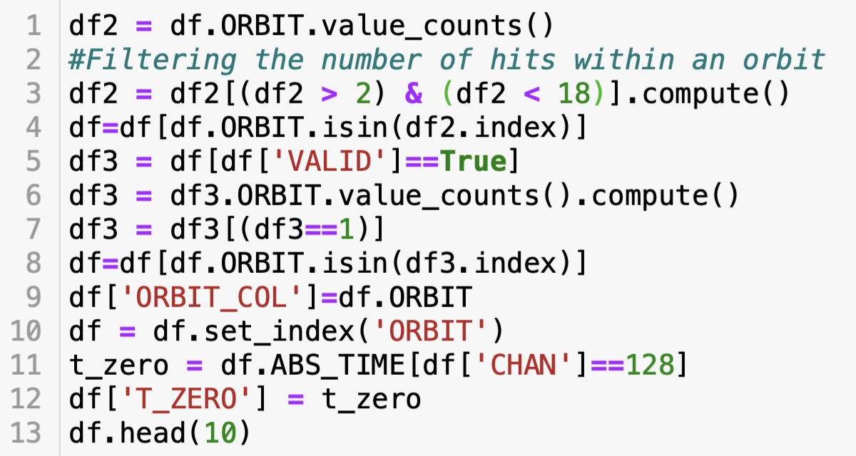
Data Filtering: first approach

